Slide 1
8085 Microprocessor

Slide 2
Introduction to 8085 Microprocessor
The 8085 is an 8-bit general purpose microprocessor
It has an addressing capacity of 16 bits. Can address 64K Byte of memory.
It has 40 pins and uses +5V for power. It can run at a maximum frequency of 3 MHz.

Slide 3
Architecture of 8085
The processor contains following functional units:
Arithmetic and Logic Unit
General purpose registers
Special purpose registers
Instruction registers and decoders
Timing and control unit

Slide 4
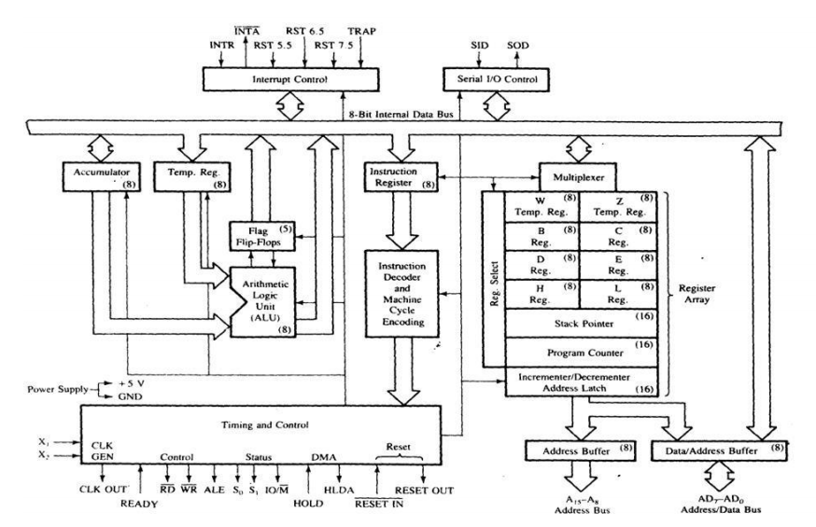
Architecture of 8085

Slide 5
Arithmetic & Logic Unit (ALU)
ALU of 8085 performs 8-bit arithmetic operations & logical operations.
Addition (ADD), Subtraction (SUB), increment (INR), decrement (DCR), and comparison (CMP) are the arithmetic operations.
Possible logic operations are AND, OR, EXOR, and complement (CMA)

Slide 6
Arithmetic & Logic Unit (ALU)
ALU of 8085 is called accumulator-oriented ALU.
The operations are generally performed with Accumulator as one of the operands. The result is saved in accumulator register.
ALU of 8085 performs:
8 bit additions with/without carry
16 bit addition
2 digit BCD addition
8 bit subtraction with/without borrow
8 bit logical operations

Slide 7
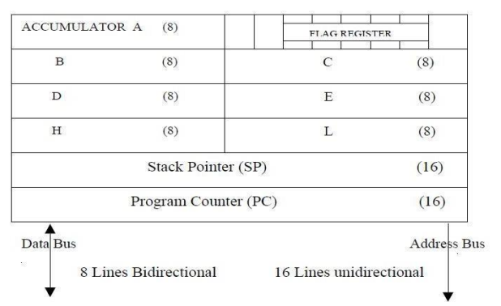
Register Structure

Slide 8
General Purpose Registers
The general purpose registers are used to store only the data that is being used by the program under execution and the results obtained from it.
These general purpose registers are user accessible through programs

Slide 9
General Purpose Registers
B,C,D,E,H,L – General purpose registers each of 8 bit. These registers can also be used for 16-bit operations in pairs.
They can work in pairs such as B-C, D-E and H-L to store 16-bit data.
The H-L pair works as a memory pointer.

Slide 10
Special Purpose Registers
Accumulator
Status or Flag Register
Instruction Register
Program Counter
Stack Pointer

Slide 11
Accumulator
The accumulator is an 8-bit register used to store 8-bit data and performs arithmetic and logical operations.
It also works as a via register for I/O accesses i.e. it reads data from input device and similarly can transfer data to output device.

Slide 12
Status or Flag Register
Flag register is a group of flip flops used to give status of different operations result.
The flag register is connected to ALU.
Once an operation is performed by ALU the result is transferred on internal data bus and status of result will be stored in flip flops.

Slide 13
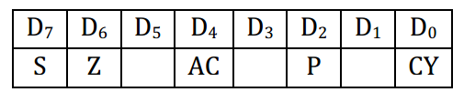
Status or Flag Register
They are called Zero (Z), Carry (CY), Sign (S), Parity (P), and Auxiliary Carry (AC) flags.

Slide 14
Sign flag (S)
The sign flag is set if bit D7 of the accumulator is set after an arithmetic or logic operation.
Zero flag (Z)
Set if the result of the ALU operation is 0. Otherwise is reset. This flag is affected by operations on the accumulator as well as other registers. (DCR B).
Auxiliary Carry (AC)
This flag is set when a carry is generated from bit D3 and passed to D4 . This flag is used only internally for BCD operations.

Slide 15
Parity flag (P)
After an ALU operation, if the result has an even number of 1s, the P-flag is set. Otherwise it is cleared. So, the flag can be used to indicate even parity.
Carry flag (CY)
This flag is set when a carry is generated from bit D7 after an unsigned operation.

Slide 16
For example 1100 0000 1000 0000 When we add the above two numbers, the carry flag is set as a carry is generated

Slide 17
Carry flag (CY) Vs. auxiliary carry flag (AC) Consider the two numbers given below 0000 1100 0000 1001
When we add both the numbers a carry is generated in the fourth bit from the LSB. This sets the auxiliary carry flag.
whenever there is a carry in the most significant bit Carry flag is set.
While an auxiliary carry flag is set only when a carry is generated in bits other than the most significant bit

Slide 18
Program Counter (PC)
This 16-bit register deals with sequencing the execution of instructions.
This register is a memory pointer. Memory locations have 16-bit addresses, so, it is a 16-bit register.
The function of the program counter is to point to the memory address from which the next byte is to be fetched.

Slide 19
Stack Pointer (SP)
A stack is a portion of RAM (Random access memory).
The stack pointer is also a 16-bit register used as a memory pointer.
The beginning of the stack is defined by loading 16-bit address in the stack pointer.

Slide 20
Stack Pointer (SP)
Each time when the data is loaded into stack, Stack pointer gets decremented.
Conversely it is incremented when data is retrieved from stack

Slide 21
Instruction Register and Decoder
Instruction register is an 8-bit register which temporarily stores the current instruction of a program.
Latest instruction is sent here from memory prior to execution.
Decoder then takes instruction and decodes or interprets the instruction.

Slide 22
The Instruction Decoder accepts an OPCODE from instruction register, decodes it and gives the decoded information to control logic.
The control logic then provides control signal

Slide 23
Temporary Registers
The temporary registers W and Z are intended for internal use of the processor and it cannot be used by the programmer.

Slide 24
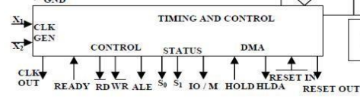
Timing And Control Unit
It synchronizes the registers and flow of data through various registers and other units.
It accepts data from instruction decoder and issues control, status and DMA signals on data bus, address bus and control bus.

Slide 25
Timing And Control Unit
Control signals associated with Timing and control unit are:
ALE is used for provide control signal to synchronize the components of microprocessor and timing for instruction to perform the operation.
RD (Active low) and WR (Active low) are used to indicate whether the operation is reading the data from memory or writing the data into memory respectively.

Slide 26
Timing And Control Unit
Status signals associated with Timing and control unit are:
S0, S1, IO/M’
IO/M (Active low) is used to indicate whether the operation belongs to the memory or peripherals.

Slide 27
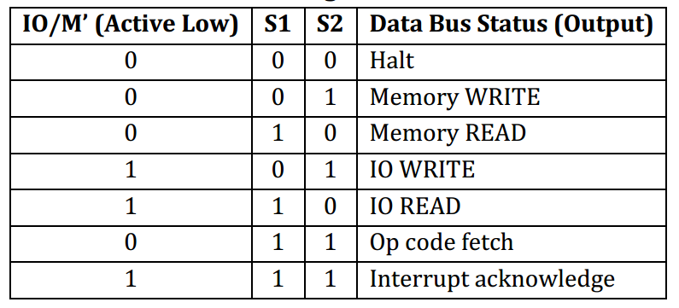
Status signals and the status of data bus

Slide 28
DMA Signals: HOLD, HLDA, READY
HOLD: Indicates that another device/master is requesting the use of the address and data buses.
HLDA: Hold Acknowledge: Indicates that the CPU has received the HOLD request
READY: This signal synchronizes the fast CPU and the slow memory, peripherals.

Slide 29
Reset Signals: Reset in, Reset Out
RESET IN (active low):
Sets the program counter to zero (0000H)
Force the 8085 to execute the first instruction from address 0000H.
RESET OUT (active high):
indicates that the processor is being reset.
This signal is synchronized to the processor clock and it can be used to reset other devices connected in the system

Slide 30
Address Buffer
The contents of the stack pointer and program counter are loaded into the address buffer and address/data buffer.
These buffers are then used to drive the external address bus and address/data bus.

Slide 31
Data Bus
The data bus in8085 is of 8 parallel lines D0 – D7
It is bi-directional as Microprocessor requires to send or receive data from/to memory and peripherals.

Slide 32
Address Bus
The bus over which the microprocessor sends out the address of a memory location or I/O location is called as the address bus.
In 8085 address bus is 16 bit A0 – A15
8085 can transfer maximum 16 bit address, which means it can address 65,536 different memory locations.

Slide 33
Address Bus
This bus is multiplexed with 8 bit data bus. So, the most significant bits (MSB) of address goes through Address bus and LSB goes through multiplexed data bus (AD0 – AD7).

Slide 34
Control Bus
The control bus is used for sending control signals to the memory and I/O devices.
The CPU sends control signal on the control bus to enable the outputs of addressed memory devices or I/O port devices.
Some of the control bus signals are as follows:
Memory read
Memory write
I/O read
I/O write.

Slide 35
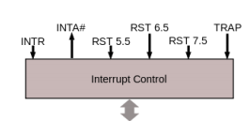
Interrupt control
INTR: Interrupt request is a general-purpose interrupt.
INTA : This is used to acknowledge an interrupt.
RST 7.5, RST 6.5, RST 5.5 – restart interrupt: These are vectored interrupts and have highest priority than INTR interrupt.
TRAP: This is a non-maskable interrupt and has the highest priority.

Slide 36
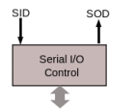
Serial Input/output control
The input and output of serial data can be carried out using 2 instructions in 8085.
SID (Serial Input Data)
SOD (Serial Output Data)

Slide 37
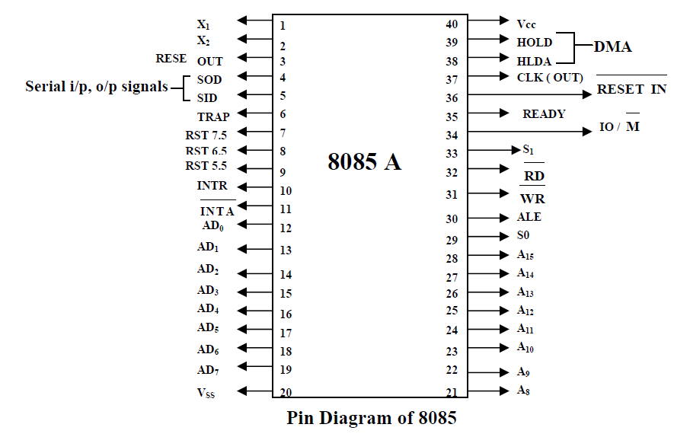
Pin Diagram of 8085 Microprocessor

